Slide 1
Migrating from RKE1 to RKE2
Session ID Number
Matthew Mattox

Slide 2

Agenda
Why Migrate from RKE1 to RKE2?
Managing Multi-Cluster Environments with Rancher
Migration Strategies: Lift-and-Shift | Rolling | Phased
Persistent Data Migration with Longhorn & pv-migrate
Demo: Workload Migration from RKE1 → RKE2
Troubleshooting Migration Challenges
Q&A & Discussion

Slide 3

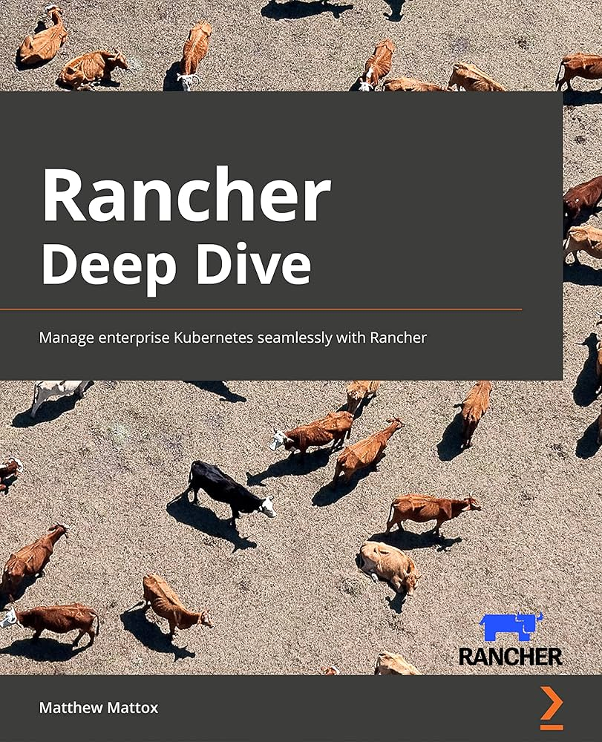
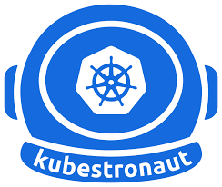
Matthew Mattox Principal Support Engineer at SUSE (6Yrs) Training:rancher.academy
GitHub: github.com/supporttools
Blog: support.tools
Author of Rancher Deep Dive
Kubestronaut

Slide 4
Why Migrate from RKE1 to RKE2?
RKE1 End of Life (EOL) - July 31, 2025 Official SUSE Announcement: https://www.suse.com/support/kb/doc/?id=000021513
RKE1 will no longer receive updates, security patches, or support after July 31, 2025.
Organizations must transition to RKE2 to maintain a supported and secure Kubernetes environment.
Delaying migration increases operational risk due to lack of security updates and compatibility issues with future Kubernetes versions.
Why RKE2?
Improved Security: SELinux support, FIPS compliance
Better Performance: Containerd, optimized networking
Long-Term Stability: Upstream Kubernetes alignment
Rancher Integration: Multi-cluster management, rolling upgrades

Slide 5
More Reasons You Might Need to Migrate Your Kubernetes Clusters
Moving into and out of the cloud Migrate workloads between cloud providers or transition on-prem to cloud for cost savings, compliance, or flexibility.
Disaster Recovery (DR) & High Availability Ensure business continuity by maintaining a failover cluster or running workloads across multiple regions.
Foundational Changes & Infrastructure Upgrades Upgrade Kubernetes versions, storage backends, or networking stacks with minimal downtime.

Slide 6
Moving Into and Out of the Cloud
Organizations move workloads between cloud and on-prem for cost, compliance, performance, and vendor flexibility.
Challenges:
Networking Differences – VPC configurations, CNI plugins, and ingress controllers may need reconfiguration.
Cloud Storage Differences – Persistent volume formats are cloud-specific (e.g., AWS EBS vs. Azure Disks).
IAM & Security Policies – Role-based access control (RBAC) and firewall rules need to be updated.
Example Use Cases:
AWS EKS → RKE2 on-prem for cost control and compliance.
Migrating from self-managed Kubernetes → managed services (EKS, AKS, GKE).
Hybrid & Multi-Cloud Scaling – Distribute workloads across cloud and on-prem for resilience.

Slide 7
Disaster Recovery (DR) & High Availability
Why It Matters
Minimize downtime – Ensure workloads remain available during failures.
Protect against outages – Cloud, network, or hardware failures can impact critical services.
Regulatory compliance – Many industries require business continuity plans.
Challenges
Keeping Stateful Applications in Sync – Databases and persistent volumes need consistent replication.
Failover Orchestration – Switching traffic between clusters using DNS, load balancers, or BGP.
Storage & Data Replication – Ensuring persistent data (PVs, databases) is available in both clusters.
Example Use Cases
Active-Passive Setup – A secondary cluster on standby, ready to take over.
Geo-Redundant Deployments – Workloads run across multiple regions for fault tolerance.
Automated DR Testing – Regular failover simulations to validate disaster recovery plans.

Slide 8
Foundational Changes & Infrastructure Upgrades
Why Migrate?
Adopt New Kubernetes Architectures – Move from outdated environments to modern, secure, and optimized clusters.
Improve Performance & Scalability – Upgrade networking, storage, and runtime components for efficiency.
Enhance Security & Compliance – Implement Pod Security Standards (PSS), SELinux, and RBAC improvements.
Challenges
Migrating Workloads While Maintaining Dependencies – Ensuring ConfigMaps, Secrets, and RBAC roles are properly transferred.
Networking & Ingress Controller Changes – Switching from Flannel → Cilium or upgrading Ingress-NGINX can impact services.
Storage Backend Migration – Transitioning from NFS → Longhorn or Ceph → Rook without data loss.
Example Use Cases
Switching Container Runtimes – Migrating from Docker → Containerd for Kubernetes compatibility.
Upgrading Storage Solutions – Moving from traditional NFS storage to cloud-native Longhorn for better resilience.
Kubernetes API & Version Changes – Ensuring compatibility with deprecations and new security policies.

Slide 9
Choosing the Right Migration Strategy
Why Migration Strategy Matters
Migrating workloads between clusters isn’t a one-size-fits-all process.
The right strategy depends on:
Timeline – How fast do you need to move?
Risk Tolerance – Can you afford downtime or need a gradual transition?
Team Involvement – Will this be admin-driven or do app teams need control?
Cluster Differences – Are you making minimal changes or a major infrastructure shift?
Three Common Strategies for Cluster Migration
Lift-and-Shift – Move everything at once, minimal changes.
Rolling Migration – Move one application at a time, working with app teams.
Phased Migration – Build a new cluster, let app teams migrate at their own pace.
Each approach has trade-offs between speed, risk, and control. Let's break them down.

Slide 10
Lift-and-Shift Migration
What is Lift-and-Shift?
You, as the cluster admin, move all workloads from one cluster to another in one big move.
Little to no changes are made to applications or configurations.
Works best when workloads are compatible with the new cluster.
Pros
Fastest migration method – Everything moves at once.
Minimal involvement from app teams – Admin-driven.
Works well when clusters are nearly identical (same Kubernetes version, storage, etc.).
Cons
Higher risk of failures – No gradual testing phase.
Potential downtime – Some workloads may need to restart in the new cluster.
Infrastructure differences – Network, storage, and security differences may require post-move fixes

Slide 11
Rolling Migration
What is Rolling Migration?
You, as the cluster admin, move applications one at a time in coordination with the app teams.
You, make small to medium size changes to the applications in-order to better use the new environment.
Each app team tests, updates, and validates their services in the new cluster before fully migrating.
More controlled approach, reducing risk and ensuring stability.
Pros
Minimized risk – Applications are moved gradually.
App teams validate their own workloads – Less troubleshooting after migration.
No major downtime – Old cluster stays online while workloads migrate.
Cons
Slower migration process – Requires coordination with multiple teams.
Potential inconsistencies – If teams don’t migrate in sync, dependencies may break.
Higher resource costs – Both clusters run in parallel until the migration is complete.

Slide 12
Phased Migration
What is Phased Migration?
You, as the cluster admin, build a new cluster and inform app teams that they need to migrate.
The responsibility is on app teams to move their workloads when ready.
Cluster stays online until everything is moved, then the old cluster is decommissioned.
Pros
Less work for cluster admins – App teams handle their own migrations.
Flexibility – Teams move on their own timeline, reducing coordination pressure.
Great for major infrastructure changes – Teams can refactor if needed before moving.
Cons
Unpredictable timeline – Some teams may delay migration, leaving two clusters running longer.
Potential inconsistencies – If teams don’t migrate in a structured way, dependencies may break.
May require temporary workarounds – Cross-cluster communication might be needed during migration.

Slide 13
Migration Methods – Choosing the Right Approach
Why Choosing the Right Migration Method Matters
Different workloads and environments require different migration techniques.
Key factors to consider:
Are your workloads stateless or stateful?
Do you need a fast migration or a controlled process?
How critical is data consistency?
Common Migration Methods:
YAML Export/Import – Quick and simple method for stateless workloads.
DR-Syncer – A tool designed to sync namespaces and Persistent Volumes across clusters.
Velero / CloudCasa – Best for full-cluster backups and restores.
Redeploy – Using GitOps or CI/CD pipelines to provision workloads from scratch in a new cluster.

Slide 14
YAML Export/Import
How It Works
Export workloads using: kubectl get resource -o yaml > backup.yaml
Apply them in the new cluster with: kubectl apply -f backup.yaml
Pros
Fast and simple, no extra tools required.
Good for stateless workloads (Deployments, Services, ConfigMaps).
Cons
No Persistent Volume (PV) migration, must move storage separately.
Manual and error-prone, requires dependency handling.
Best for: Small workloads, quick transitions, and environments without persistent data.
Open Source Tool:
GitHub: mattmattox/kubebackup

Slide 15
DR-Syncer
How It Works
Replicates Deployments, Services, ConfigMaps, Secrets, Persistent Volumes, etc. across clusters.
Ensures scheduled syncing for seamless migration.
Pros
Purpose-built for Kubernetes migrations/DR – Handles both workloads and PVs.
Minimizes downtime – Keeps namespaces and data synchronized across clusters.
More efficient than manual YAML exports – Reduces human error.
Cons
Requires setup & configuration – Not a native Kubernetes feature.
May need cluster connectivity – Ensure network policies allow cross-cluster syncs.
Requires similar cluster setup – The target cluster should match the source.
Target cluster must have storage configured – Ensure PVs can be replicated properly.
Best for: Stateless and Stateful applications that need replication between clusters.
Open Source Tool: GitHub: supporttools/DR-Syncer

Slide 16
Velero / CloudCasa
How It Works
Backup workloads in the old cluster using Velero or CloudCasa.
Restore them in the new cluster, including Persistent Volumes.
Pros
Works across cloud and on-prem clusters.
Backs up all workloads, including PVs, RBAC, and secrets.
Cons
Requires object storage (AWS S3, MinIO, Azure Blob).
May be slow for large clusters with many Persistent Volumes (PVs).
CloudCasa is a paid service and requires a license.
Best for:
Full-cluster migrations needing persistent storage and security settings.
Backup and disaster recovery strategies.
https://cloudcasa.io/blog/seamless-migration-from-rke-to-rke2-with-cloudcasa-a-suse-partner-solution/

Slide 17
Redeploy
How It Works
Update the target cluster in your pipelines to reflect the new environment.
Deploy a fresh environment in the new cluster using Helm, Kustomize, or GitOps (ArgoCD, Flux).
Migrate data separately using snapshots, database replication, or manual restores.
Pros
Ensures a clean deployment, avoiding legacy config issues.
Best for infrastructure upgrades or Kubernetes version changes.
Cons
No automatic PV migration, must handle database and storage manually.
Takes more time, especially for complex applications.
Requires applications to be fully defined as code (IaC/GitOps).
Best for:
Organizations following Infrastructure-as-Code (IaC) or GitOps practices.
Teams migrating to declarative deployments for better reproducibility.

Slide 18
Data Migration with Longhorn
How It Works
Longhorn’s Disaster Recovery (DR) volumes sync with a backup cluster on a scheduled basis using incremental restores.
The DR volume is created from a volume’s backup in the backupstore.
Scheduled backup intervals determine how frequently data is updated.
If the original volume fails, the DR volume can be activated in the backup cluster for fast recovery.
Pros
Scheduled Data Syncing – Uses periodic snapshots and incremental restoration.
Faster Recovery vs. Full Backup Restores – Avoids the need to recover the entire volume from scratch.
Built-in with Longhorn – No additional tools required for Longhorn users.
Cons
Not real-time replication – Data is only as current as the last scheduled backup.
No live snapshots or backups on DR volumes – Backups must be restored before activation.
Recovery Point Objective (RPO) depends on backup frequency – If backups run hourly, up to one hour of data could be lost in case of failure.
Best for:
Organizations already using Longhorn for persistent storage.
Disaster Recovery (DR) planning where scheduled snapshots are acceptable.
Workloads that can tolerate some data loss (RPO > 0) in exchange for lower Recovery Time Objective (RTO).

Slide 19
Data Migration with pv-migrate
How It Works
pv-migrate is a CLI tool that copies Persistent Volume Claims (PVCs) across namespaces, clusters, or storage backends.
Uses rsync over SSH with Load Balancers, Bind Mounts, and Port-Forwarding for data transfer.
Supports multiple migration strategies, automatically selecting the most efficient method based on the environment.
Pros
Works across namespaces, clusters, and storage backends – Not tied to a specific CSI driver.
Secure migrations – Uses SSH and rsync for encrypted data transfer.
Multiple migration strategies – Falls back to different approaches when needed.
Highly customizable – Users can configure rsync/SSH images, affinity, and network settings.
Cons
Requires storage compatibility – Target storage class must support the expected access modes.
Live data requires careful handling – Works best for pre-migration syncing, not real-time replication.
Networking considerations – Cross-cluster migrations require proper network connectivity between clusters.
Best for:
Moving Persistent Volumes across namespaces or clusters.
Changing storage classes (e.g., ReadWriteOnce → ReadWriteMany).
Migrating data securely between Kubernetes clusters.
Expanding PVCs when volume resizing isn’t supported.
Open Source Tool: GitHub: utkuozdemir/pv-migrate

Slide 20
Cattle-Drive
How It Works
TBD
Pros
TBD
Cons
TBD
Best for:
TBD
https://github.com/rancherlabs/cattle-drive

Slide 21
DEMO

Slide 22
Common Migration Failures & Fixes (Part 1)
Missing Critical Cluster Services
Issue: After migration, applications fail due to missing dependencies like cert-manager, monitoring, or GitOps tools. Fix:
Ensure required cluster services are installed first (cert-manager, Prometheus, ArgoCD).
Deploy cluster-wide services before migrating workloads.
Forgetting Cluster-Scoped Resources (ClusterRoles, CRDs, etc.)
Issue: Applications fail to start because ClusterRoles, RoleBindings, or CRDs are missing.
Fix:
Export and apply CRDs before migrating workloads:
kubectl get crd -o yaml > crds.yaml
kubectl apply -f crds.yaml
Ensure RBAC rules (ClusterRoleBindings, ClusterRoles) are migrated properly. List cluster-wide resources with:
kubectl api-resources --verbs=list --namespaced=false

Slide 23
Common Migration Failures & Fixes (Part 2)
Secrets Not Stored Externally
Issue: Applications crash because Secrets were lost during migration.
Externalize secrets using Vault, AWS Secrets Manager, or Kubernetes External Secrets.
Backup secrets before migration: kubectl get secrets -A -o yaml > secrets-backup.yaml
Restore secrets manually or via GitOps after migration.
CNI Changes Impact Network Policies
Issue: A different CNI (Calico, Cilium, etc.) can change network policies, causing communication failures.
Check existing network policies before migration: kubectl get networkpolicy -A
Verify pod-to-pod and pod-to-service communication is allowed.
Update network policies to match the new CNI's behavior before migration.
Best Practices to Avoid Issues
Pre-flight validation – Run kubectl get all -A to identify missing resources.
Use GitOps (ArgoCD/Flux) to store and redeploy cluster-wide resources.
Test migration in a staging cluster before production cutover.
Document all external services and cluster-scoped dependencies before migration.

Slide 24
Q&A

Slide 25
Thank You!

